Slide 1
Intermediate Code Generation
Unit 5
Sini Anna Alex

Slide 2
The description of three-address instructions
Three address instructions can be implemented as objects or as records with fields for the operator and the operands. Three such representations are called quadruples, triples, and indirect triples.
Quadruples- A quadruple (or just quad) has four fields: op, arg1, arg2, and result.
The op field contains an internal code for the operator.
For instance, the three-address instruction x = y +z is represented by placing + in op, y in arg1, z in arg2, and x in result.

Slide 3
Quadruple Representation
The following are some exceptions to this rule:
1. Instructions with unary operators like
x = minus y or x = y do not use arg2.
For a copy statement like x = y, op is =, while for most other operations, the assignment operator is implied.
2. Operators like param use neither arg2 nor result.
3. Conditional and unconditional jumps put the target label in result. goto L

Slide 4
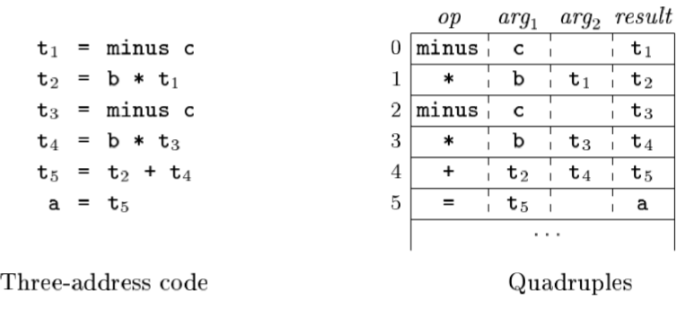
Quadruple representation of a = b*-c + b*-c

Slide 5
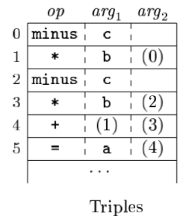
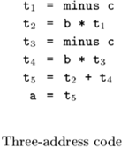
Triples
A triple has only three fields, which we call op, arg1, and arg2. With triples, the result of an operation is referred to by its position, so moving an instruction may require us to change all references to that result.
Triple Representation of a = b*-c + b*-c

Slide 6
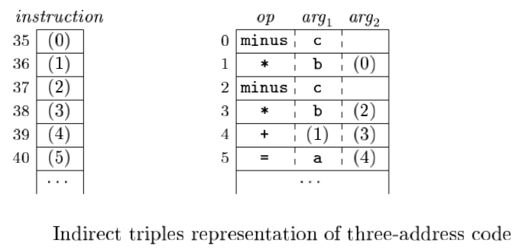
Indirect Triples
Indirect triples consist of a listing of pointers to triples, rather than a listing of triples themselves. With indirect triples, an optimizing compiler can move an instruction by reordering the instruction list, without a directing the triples themselves

Slide 7
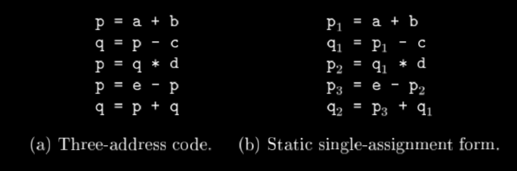
Static Single Assignment Form(SSA)
Intermediate Representation that facilitates certain code optimizations.
Intermediate program in three-address code and SSA

Slide 8


The same variable may be defined in two different control-flow paths in a program.
has two control-flow paths in which the variable x gets defined.
Here, (x1,x2) has the value x1 if the control flow passes through the true part of the conditional and the value x2 if the control flow passes through the false part.

Slide 9
Types and Declarations
The applications of types can be grouped under checking and translation:
Type checking: uses logical rules to reason about the behavior of a program at run time.
For example, the && operator in Java expects its two operands to be booleans; the result is also of type boolean.
Translation Applications: From the type of a name, a compiler can determine the storage that will be needed for that name at run time.
-For example, Type information is also needed to calculate the address denoted by an array reference, to insert explicit type conversions.

Slide 10
Type Expressions
Types have structure, which represent using type expressions:
a type expression is either a basic type or is formed by applying an operator called a type constructor to a type expression.
The array type int[2][3] can be read as “array of 2 arrays of 3 integers each" and written as a type expression array(2,array(3,integer)). The operator array takes two parameters, a number and a type.

Slide 11
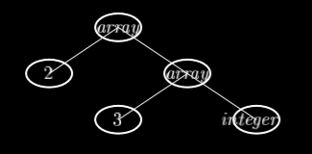
Definition of type expressions
A basic type is a type expression
A type name is a type expression.
A type expression can be formed by applying the array type constructor to a number and a type expression.
A record is a data structure with named fields. A type expression can be formed by applying the record type constructor to the field names and their types.
A type expression can be formed by using the type constructor -> for function types. We write s -> t for “function from type s to type t."
Type expression for int[2][3]

Slide 12
Type Equivalence
When are two type expressions equivalent?
Many type-checking rules have the form, “if two type expressions are equal then return a certain type else error.“
When type expressions are represented by graphs, two types are structurally equivalent if and only if one of the following conditions is true:
They are the same basic type.
They are formed by applying the same constructor to structurally equivalent types.
One is a type name that denotes the other.
The first two conditions in the above definition lead to name equivalence of type expressions. Name-equivalent expressions are assigned the same value number.

Slide 13
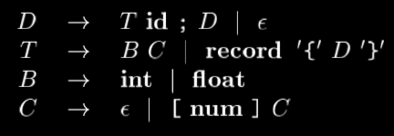
CFG for valid Declarations in C Language
* record -> can be a struct or union

Slide 14
Storage Layout for local names
From the type of a name, we can determine the amount of storage that will be needed for the name at run time.
Eg: integer means 4 bytes of storage, int A[10].
At compile time, we can use these amounts to assign each name a relative address.
A[2] array reference can be accessed by base address(A)+2*4.
The type and relative address are saved in the symbol-table entry for the name.
Symbol Table gets added with the additional specifications.
A is an identifier with type array(10,int)

Slide 15
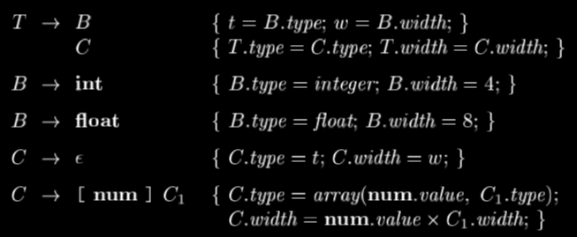
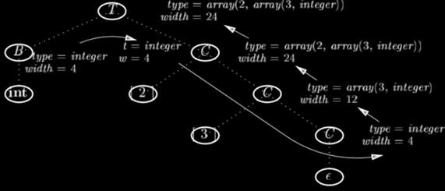
Computing types and their widths Syntax-directed translation of array types
The width of a type is the number of storage units needed for objects of that type.
A basic type, such as a character, integer, or float, requires an integral number of bytes.
SDT uses synthesized attributes type and width for each nonterminal and two variables t and w to pass type and width information.
In syntax-directed translation, t and w would be inherited attributes for C.

Slide 16
Sequences of Declarations
Languages such as C and Java allow all the declarations in a single procedure to be processed as a group.
Therefore, we can use a variable, say offset, to keep track of the next available relative address.
For eg: We have a declaration in C as given below
int a;
struct{int b; float x;}p;
Total Storage allocation should be 4 + (4+8) =16 bytes.
(For int – 4 bytes , float – 8 bytes)

Slide 17
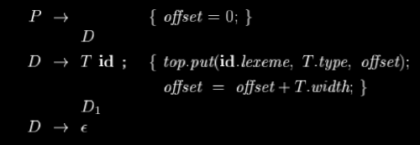
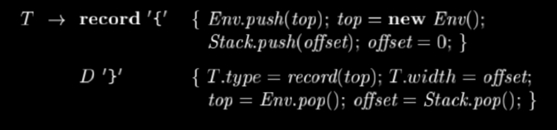

Computing the relative addresses of declared names
Handling of field names in records
A record type has the form record(t), where record is the type constructor, and t is a symbol table object that holds information about the fields of this record type
D -> T id;D1 creates a symbol table entry by executing
top . put (id . lexeme, T . type, offset). Here top denotes the current symbol table.
Class Env implement symbol tables. The call Env.push(top) pushes the current symbol table denoted by top onto a stack. Variable top is then set to a new symbol table. Similarly, offset is pushed onto a stack called Stack.

Slide 18
Compute the type and relative address for the Declaration statement given below
float x;
record { float a; float b;} p;
Use the given Grammar for computation:

Slide 19
THANK YOU

